Slide 1
Annual Review for
OpenSynth
March 2025

Slide 2

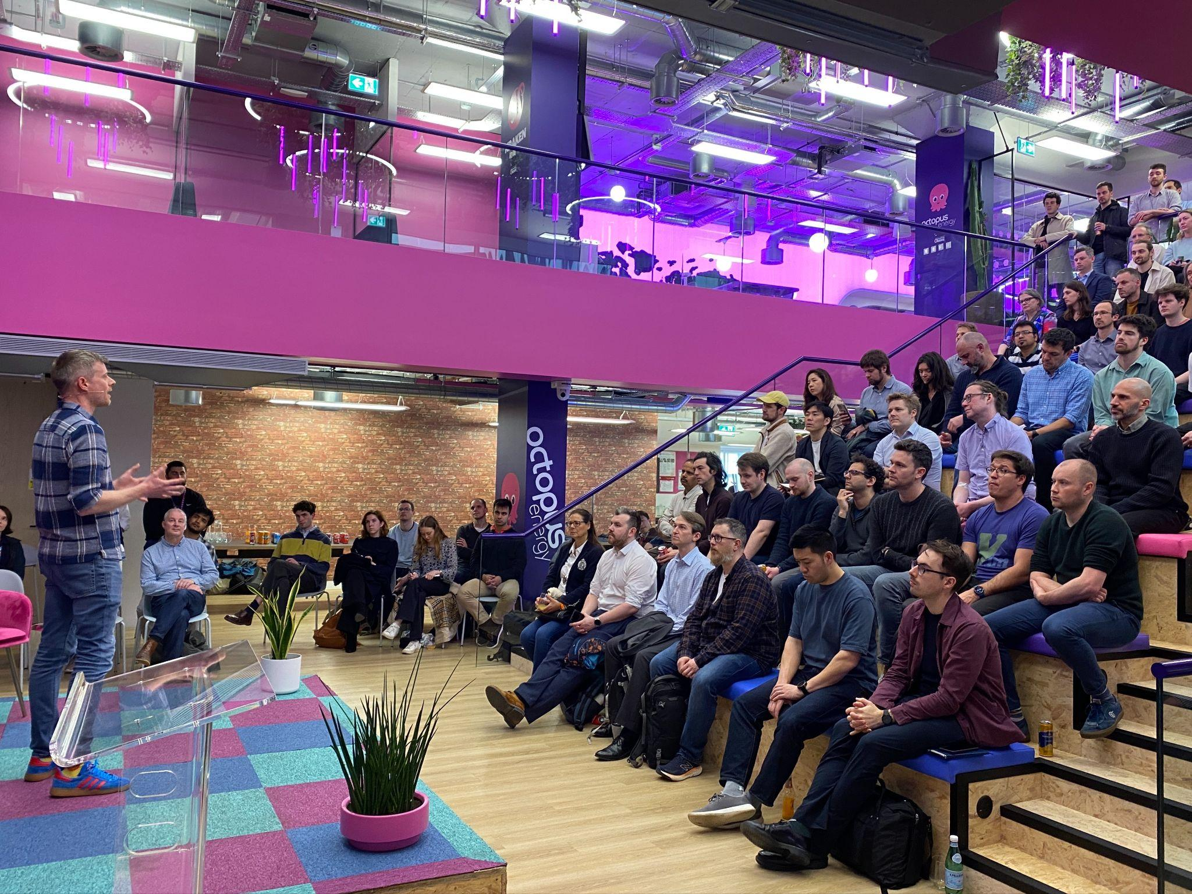
Synthetic Data Community
Create a one-stop-shop for synthetic energy data
Encourage people to create and share a diversity of data
Spread the adoption of synthetic data

Slide 3


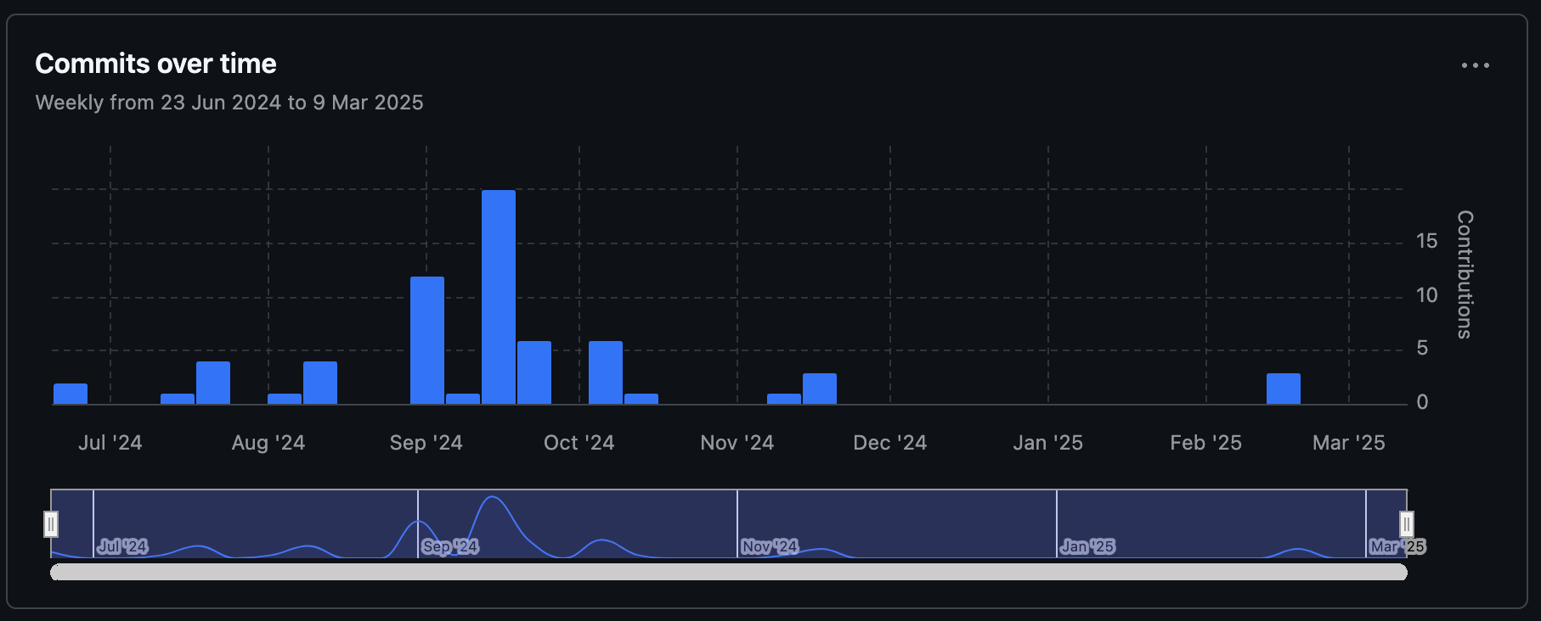
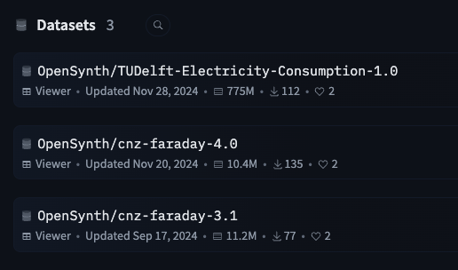
Contributions
Number of external code contributions = 1
Number of planned contributions = 1 (Alliander / TU Delft)
Number of external data contributions = 1
Number of planned contributions = 3 (HydroQuebec, CEC, Alliander / TU Delft)

Slide 4









Organizations contributing and/or using in production
Notes:
How HydroQuebec is using OpenSynth for GridFM
CEC work to get californian data
pipeline in Alliander - TU Delft working on commercial/ industrial data, new PhD starting in April on a new VAE model to do more synthetic data work

Slide 5
Key Achievements in the past year
Project incubation - Feb 24
Soft launch event - Apr 24
Defining ‘Good’: Evaluation Framework - Jul 24
Code repository and 1st model submission - Jul 24
Data repository and 1st synthetic data drop - Sep 24
3 TSC meetings - Sep 24, Nov 24, Feb 25
First external contribution - Nov 24
Scope review meeting - Feb 25

Slide 6
Areas the project could use help on
Even more contributor introductions (code and data)
Development of growth plan
Marketing? Blog posts etc.

Slide 7
Feedback on working with LF Energy
Great team, very supportive, responsive and open
Really high quality, relevant introductions so far
LF Energy Summit in particular was a really useful and impactful event

